Slide 1
NABEEL P K
214422@ust-global.com

Slide 2
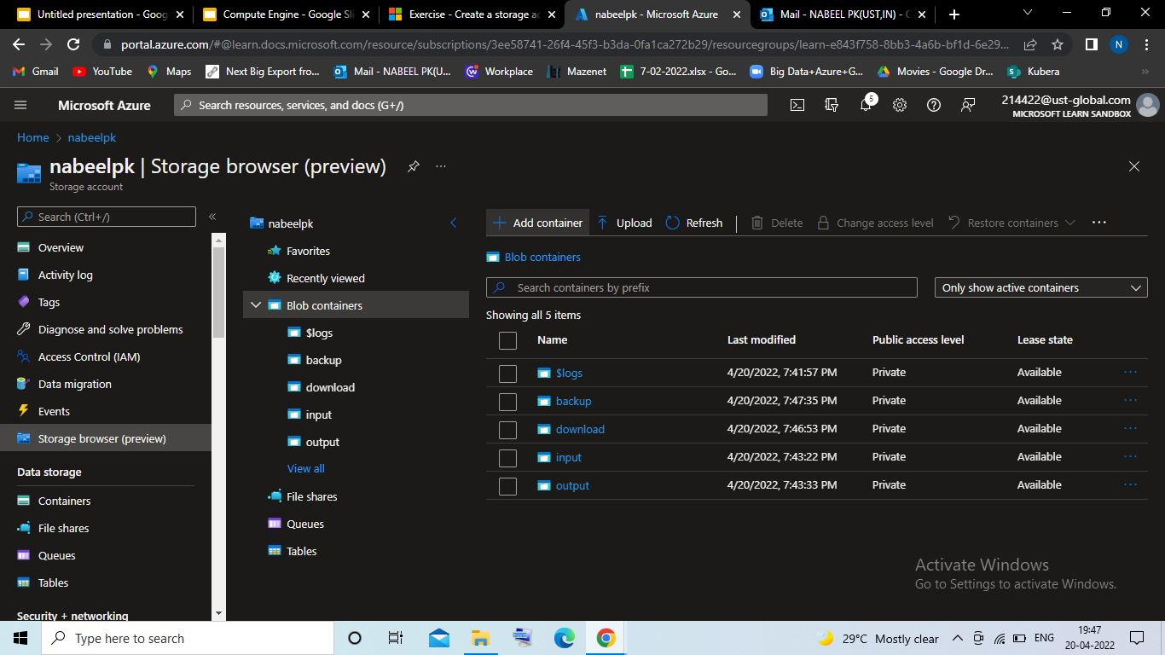
Storage Account in Azure with 4 container

Slide 3
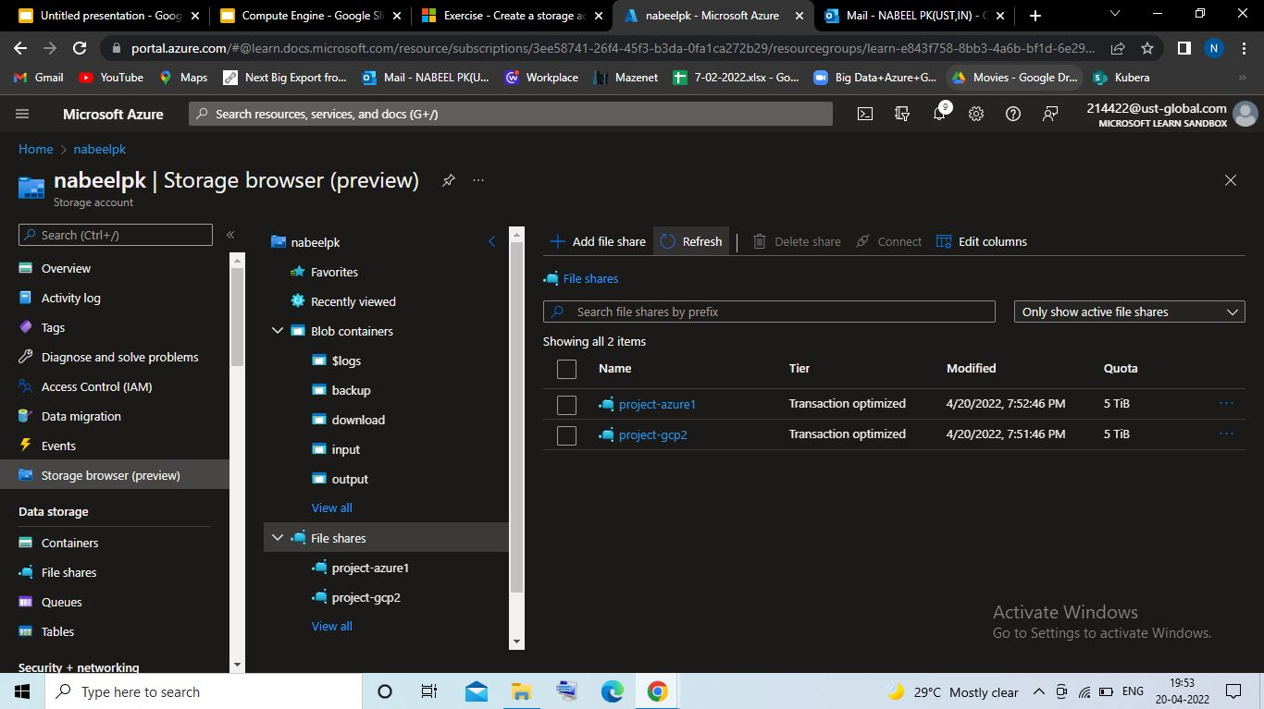
File Share with 2 directory

Slide 4
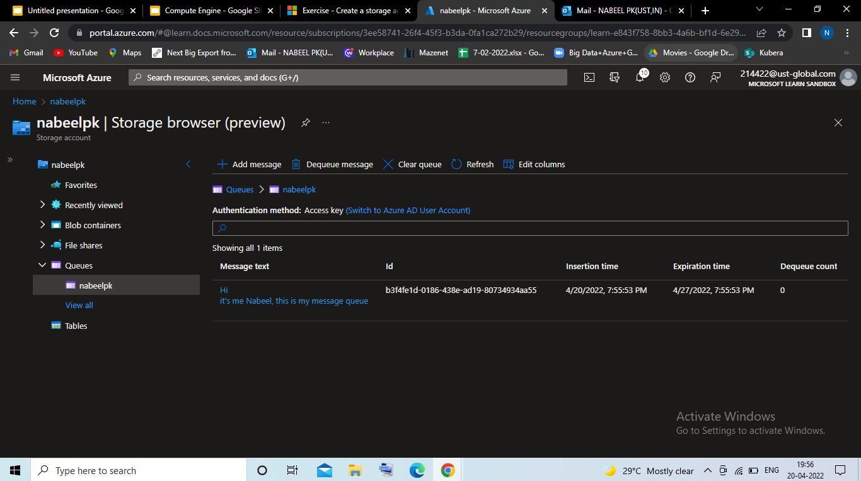
Message Queue with message

Slide 5
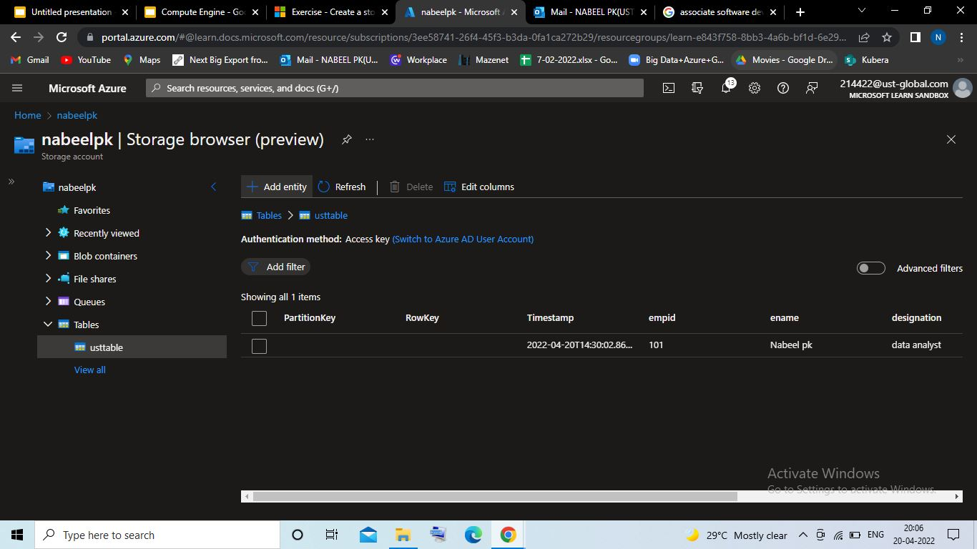
Table

Slide 6
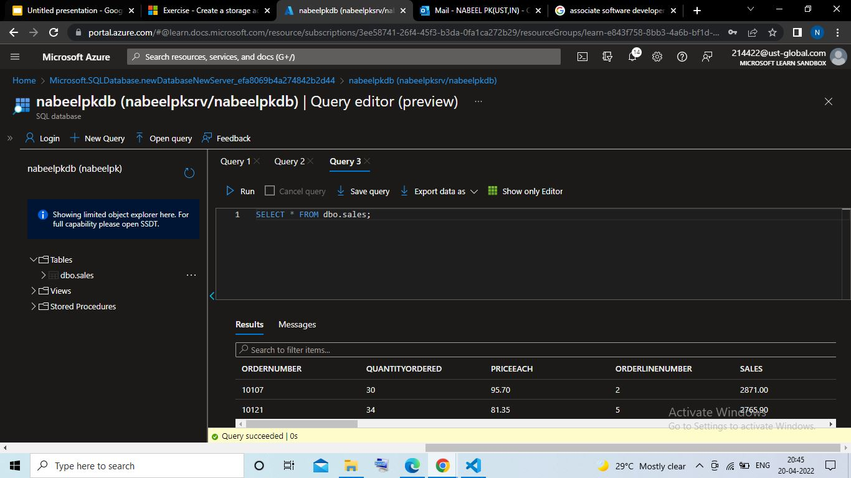
Sample Database with SQL query

Slide 7
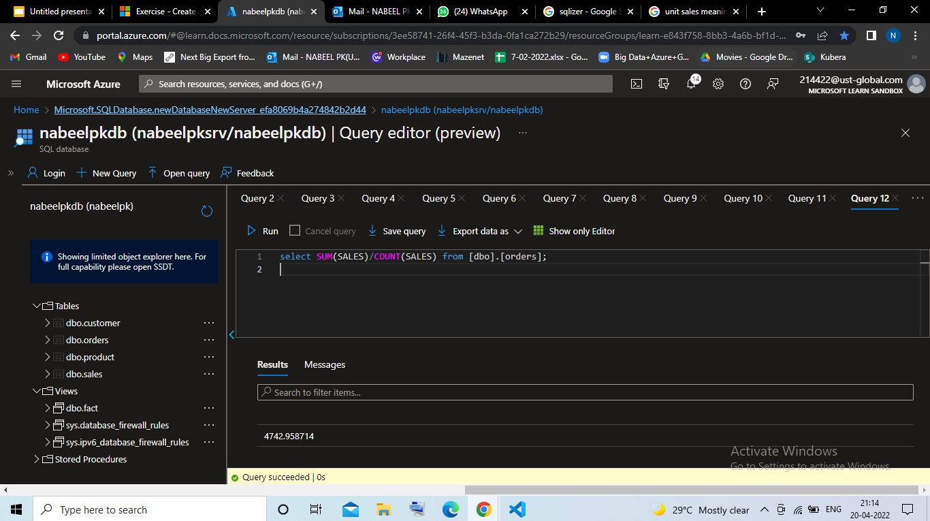
Sample database with Dimension & Fact tables-To estimate the unit sales of retail goods

Slide 8
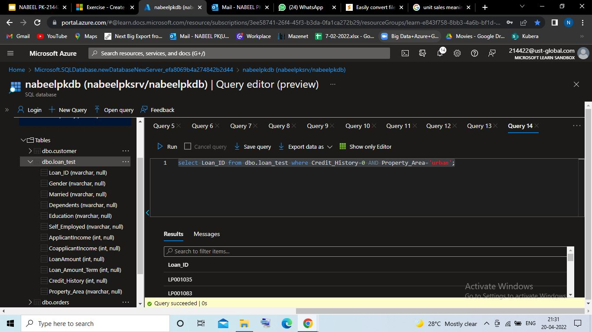
Sample database with Dimension & Fact tables-financial need programs for consumer loan products

